Slide 1
A Time Series Analysis of Gray Wolf Population in Yellowstone
Shane McIntyre
March 25th
2021

Slide 2
Presentation Overview
Importance of Wolves in an Ecosystem
My Goal
Basic Data Interpretation
Model Creation
Model Validation
Potential Other Models
5 Year Forecast of Wolf Population
Summary

Slide 3
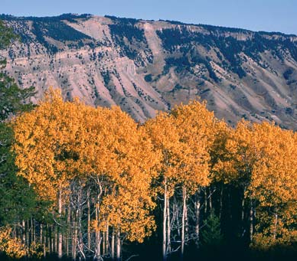
Why Wolves are Important
In 1994 the Elk population in Yellowstone reached close to 20,000. With such a high population:
Vegetation along river banks decreased, and trees such as Aspen began to disappear
Smaller animals (Beaver, Fox, Rabbit, etc.) were forced to leave, leaving Yellowstone with a lack of biodiversity
With smaller animals leaving, larger predators had a decrease in food source

Slide 4
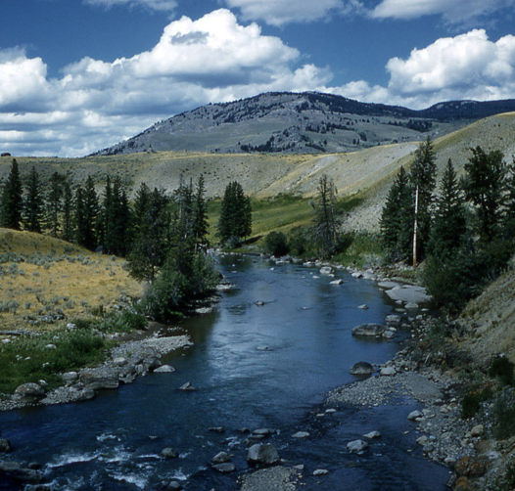
A Healthier Ecosystem
Wolves were reintroduced in 1995
Today the Elk population is around 6,000
With a monitored population, Yellowstone has seen an increase in biodiversity since 1995
Aspen can grow, along with other vegetation
Increased vegetation brings back smaller animals, which brings back larger predators
With an increase in beavers and vegetation, erosion has faded along the rivers

Slide 5
My Goal
My goal is to take population data of wolves in Yellowstone from 1995-2019, and give a forecast of potential population values over the next 5 years. Maintaining a healthy wolf population is essential to the overall health and ecosystem within Yellowstone. A population forecast, with prediction intervals that provide a lot of room for different values, will allow ecologists at Yellowstone National Park to asses how the wolf restoration project is going, and have an understanding of what future populations may look like.

Slide 6
Data Collection
Data includes Gray Wolf population in Yellowstone National Park, as well as the Northern Range, a sub-region of Yellowstone with a high density of Elk and carnivores.
Collection of 24 reports from 1995 to 2019
https://www.nps.gov/yell/learn/nature/wolf-reports.htm

Slide 7
Yellowstone Population = Total Wolf Population in Yellowstone
Year | Yellowstone Population | Northern Range
1995 | 21 | 21
1996 | 37 | 24
1997 | 80 | 32
1998 | 83 | 48
1999 | 72 | 44
Northern Range = Wolf Population in Northern Range

Slide 8
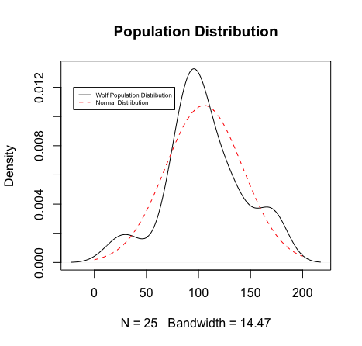
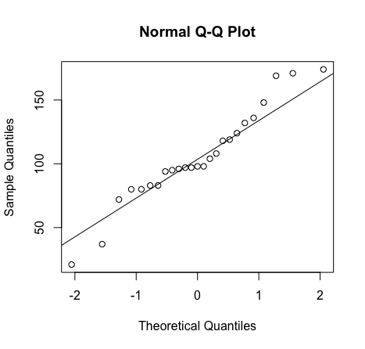
Distribution of the Data
Normality Test (Shapiro – Wilk)
W Test Statistic = 0.9511
P-Value = 0.265
This test statistic suggests the data is normally distributed

Slide 9
Basic Statistics of Wolf Population in Yellowstone
Statistic | Value
Mean | 105.36
Median | 98
Variance | 1374.99
Standard Deviation | 37.080858
Skewness | -0.013395
Kurtosis | -0.098536
*High Variance due to wide range of values between 1995-2009

Slide 10
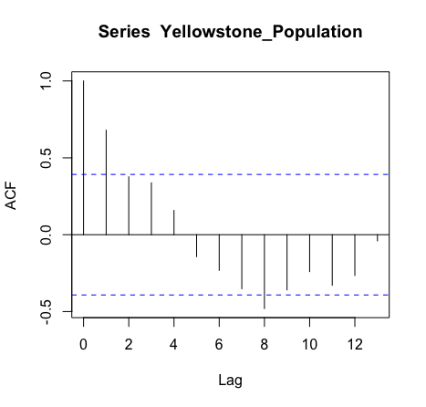
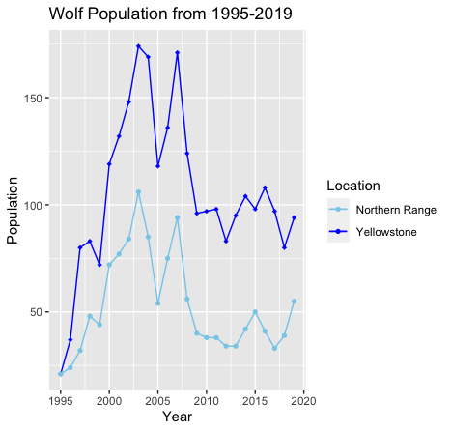
Investigating the Raw Data (Stationary vs Non-Stationary)
Ljung-Box Test:
X-squared = 20.63
Lag = 3
P-value = 0.0001257
The ACF suggests the data is non-stationary. The Ljung-Box test confirms this. A low p-value tells us to reject the null hypothesis that the data is stationary.

Slide 11
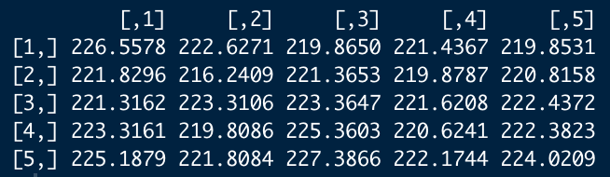
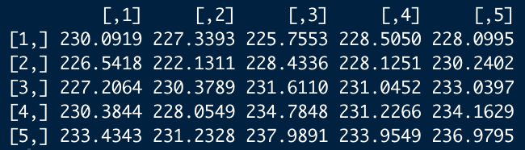
Model Creation
Data is non-stationary
Try ARIMA(p,d,q)
Seasonality d =1
Investigate different ARIMA models with p and q ranging from 1-5
Assessing potential models by minimizing AIC/BIC
Minimum AIC and BIC suggested p=2, q=2
Suggested Model
ARIMA(2,1,2)
AIC
BIC

Slide 12
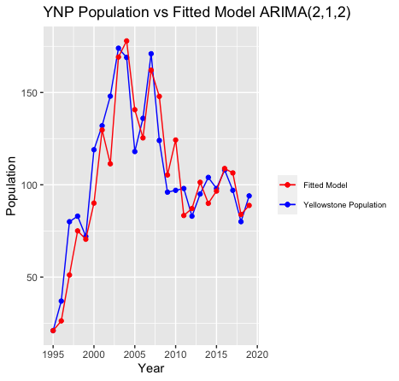
Raw Data vs Fitted Data
Blue Line
True Yellowstone Population
Red Line
Fitted ARIMA(2,1,2) model
Places of error could be due to large variance in original data
Population values change more aggressively between 1995-2009
12

Slide 13
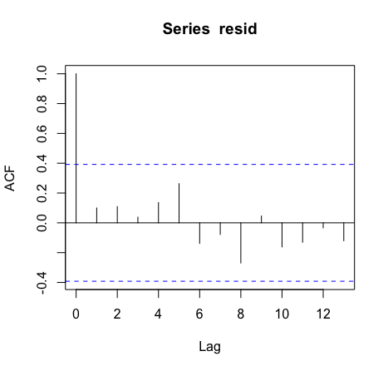

Goodness of Fit of ARIMA(2,1,2)
Goodness of Fit assessed by ACF and Ljung-Box Test
Correlation values should fall between +/- $\frac{1.96}{sqrt\left(N\right)}$
N = 25, length of data
= (-0.392, 0.392)

Slide 14
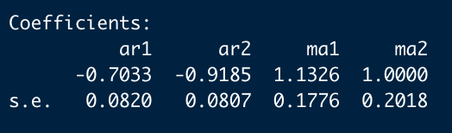
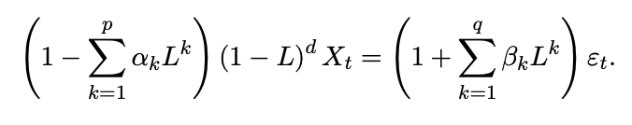
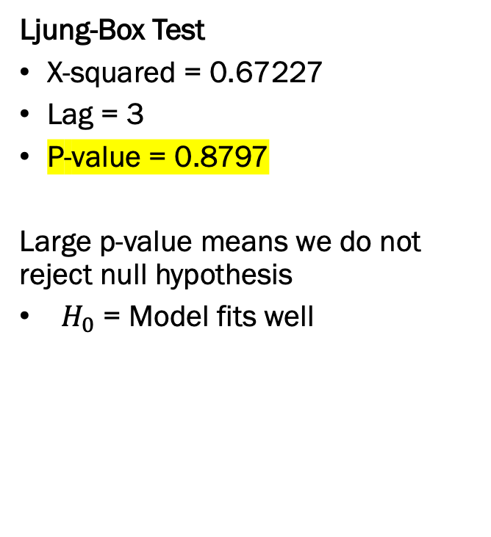
Goodness of Fit Cont.
Ljung-Box Test
X-squared = 0.67227
Lag = 3
P-value = 0.8797
Large p-value means we do not reject null hypothesis
$H_{0}$ = Model fits well
⍺ = ar1 & ar2
β = ma1 & ma2
General ARIMA Equation:

Slide 15
Potential Other Methods/Models
Other ways to account for non-stationary data is to transform the data via:
Log Transformation
Difference of Values
Did not transform data in order to give estimates in true population value
Testing of another model
ARIMA with d = 2 (Previously d = 1)
After testing different p and q coefficients that minimize AIC/BIC, suggested model was:
ARIMA(2,2,1)
p = 2
d = 2
q = 1

Slide 16
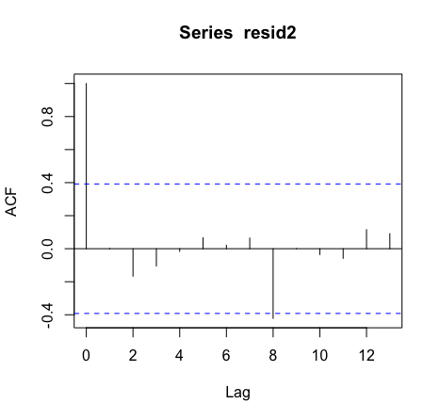
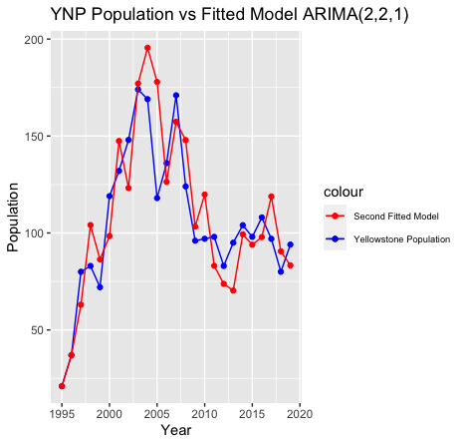
ARIMA(2,2,1)
Ljung-Box Test:
X-Squared = 1.1471
Lag = 3
P-Value = 0.7657

Slide 17
ARIMA(2,1,2) vs ARIMA(2,2,1)
Ljung-Box Test
P-Value = 0.8797
Ljung-Box Test
P-Value = 0.7657

Slide 18
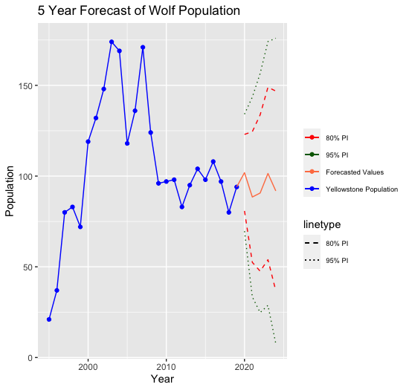
Forecasted Values Over Next 5 Years Using ARIMA(2,1,2)
Year | Forecasted Gray Wolf Population
2020 | 102
2021 | 88
2022 | 91
2023 | 101
2024 | 92

Slide 19

Summary of Analysis
Did not transform data when I usually would for a Time Series
Wanted to give true population estimates
5 year forecast of wolf population
Ranges between 88 and 102
Population appears to be leveling out
If trend continues, data could become stationary
If data becomes stationary over time, more accurate prediction intervals could be forecasted
ARIMA(2,1,2)
P-value = 0.8797
ARIMA(2,2,1)
P-value = 0.7657
ACF plots of both models had ACF values fall between +/- $\frac{1.96}{sqrt\left(N\right)}$, but the ACF of ARIMA(2,1,2) was slightly better at Lag = 8

Slide 20
Potential Future Projects
Look into how wolves have affected water levels in Yellowstone. Correlation Study of wolf population to river flow
Correlation of wolf population and other animals
Study of tourism trends since 1995

Slide 21
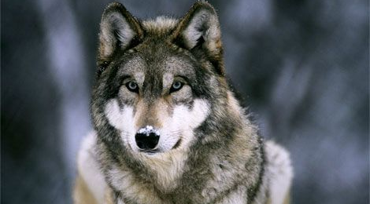
Thank you!

Slide 22
Informal Citations
https://mountainjournal.org/fewer-elk-counted-in-yellowstone-this-year-but-it-cannot-be-blamed-on-wolves#:~:text=The%20long%2Dterm%20average%20of,3%2C915%20elk%20observed%20in%202013.
https://www.yellowstonepark.com/things-to-do/wolves-bring-yellowstone-back
https://kids.britannica.com/students/assembly/view/174079
https://www.nps.gov/yell/learn/nature/elk.htm#:~:text=The%20Greater%20Yellowstone%20Ecosystem%20is,than%20the%20northern%20Yellowstone%20herd.
https://earthjustice.org/blog/2015-july/how-wolves-saved-the-foxes-mice-and-rivers-of-yellowstone-national-park
https://yellowstone.co/rivers/lamar.htm
https://www.fanpop.com/clubs/wolves/images/37008073/title/beautiful-wolf-photo

